Slide 1
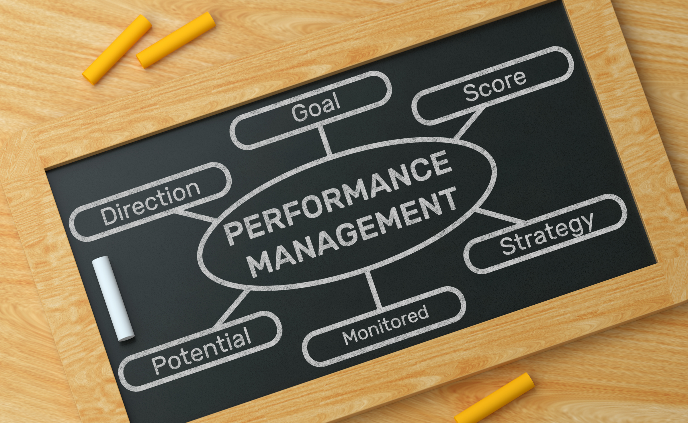
EMPOWERING GROWTH
NAVIGATING THE PERFORMANCE MANAGEMENT PROCESS

Slide 2



KEY PRINCIPALS
  Performance is a relationship, not a transaction
  Focus on feedback conversations, not compliance
  Employee-centered and values-driven
  Continuous and regular dialogue throughout the year
  Not tied to any increase

Slide 3
OVERVIEW
01
SEPT. - OCT.
02
Employee goal setting & clarifying expectations meeting w/ employee & supervisor
OCT. - DEC.
Regular check-ins on goals required quarterly between supervisor and employee (Aug., Nov., Feb., & May)
  Increased frequency is highly encouraged
Regular check-ins
(bi-weekly, monthly, etc.)
03
JAN. – FEB.
FEB. – APR.
04
Mid-year review, informal, non-scoring
Regular check-ins
(bi-weekly, monthly, etc.)
05
APR. - MAY
Year-end reflection & planning meeting w/ employee & supervisor

Slide 4
FEEDBACK REFLECTION TOOL
Category | Definition | Behaviors You May See | Growth Focus
Not Started | Has not started actions toward completing goal. Still building knowledge, skills, or confidence in area. Needs additional support and practice. | Inconsistent execution, requires frequent guidance | Identify specific skill gaps and create short-term goals for improvement
In Progress | Taken some actions towards goal completion. Demonstrates growing competence and independence. Sometimes meets expectations, with room to grow. | Sometimes meets expectations, shows initiative, progressing with few reminders or guidance | Focus on consistency, confidence, and moving toward full independence
Completed | Successfully completed goal. Consistently performs at expected level with quality and reliability | Delivers solid, reliable work, demonstrates values in action, requires minimal supervision/guidance | Consider stretching goals, mentoring others, or pursuing innovation in specific area

Slide 5
RESOURCES CREATED
  Performance Timeline Overview
  Performance Process in Detail with Resources and Actions
  Clarity & Initial Priorities Check-in Worksheet (Supervisor instructions separate)
  Creating SMART Goals
  Asking for Feedback
  Check-in Discussion Questions
  Self-Reflection & Assessment Questions
  End of Year Reflection Facilitation Guide

Slide 6
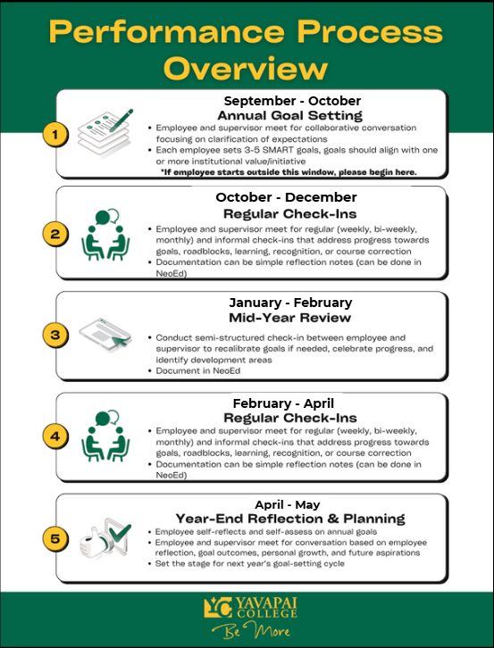
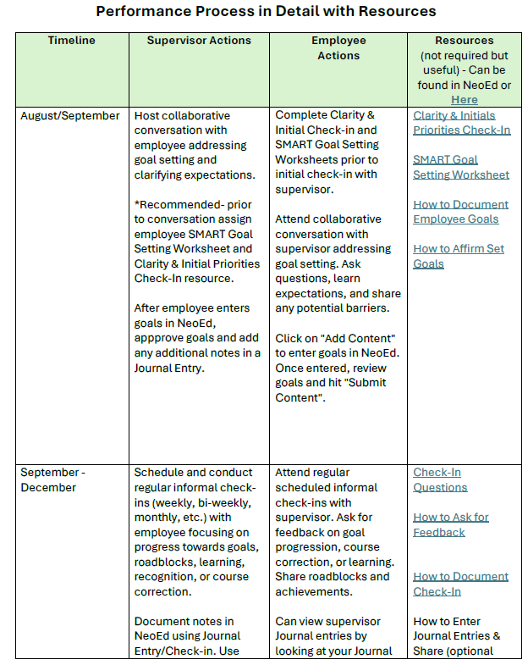
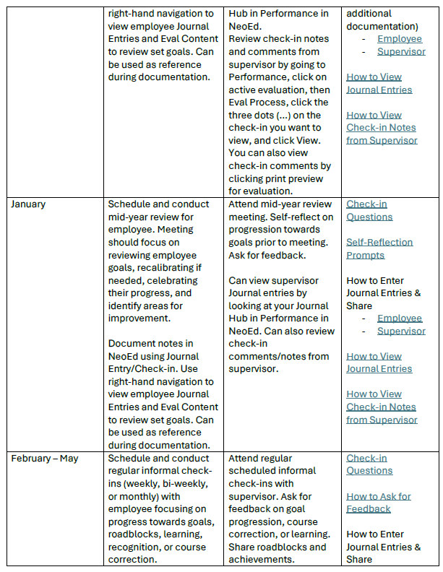
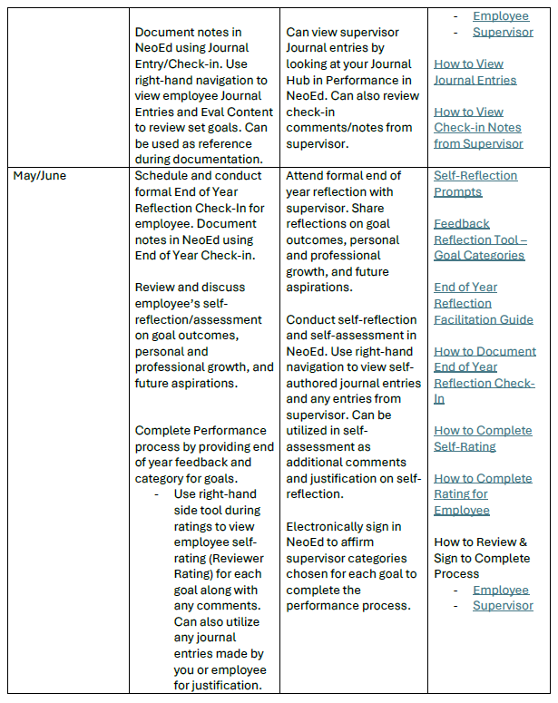

Slide 7
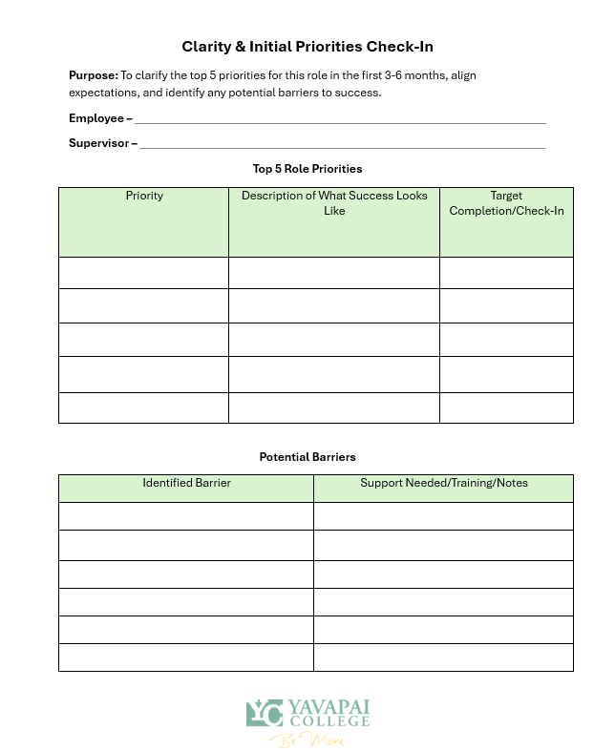
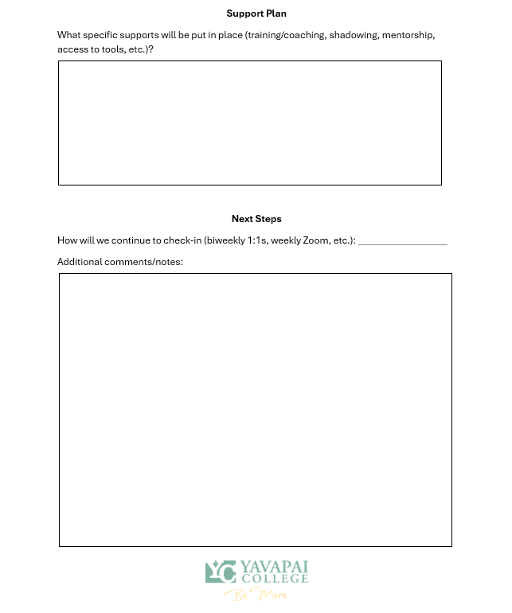

Slide 8
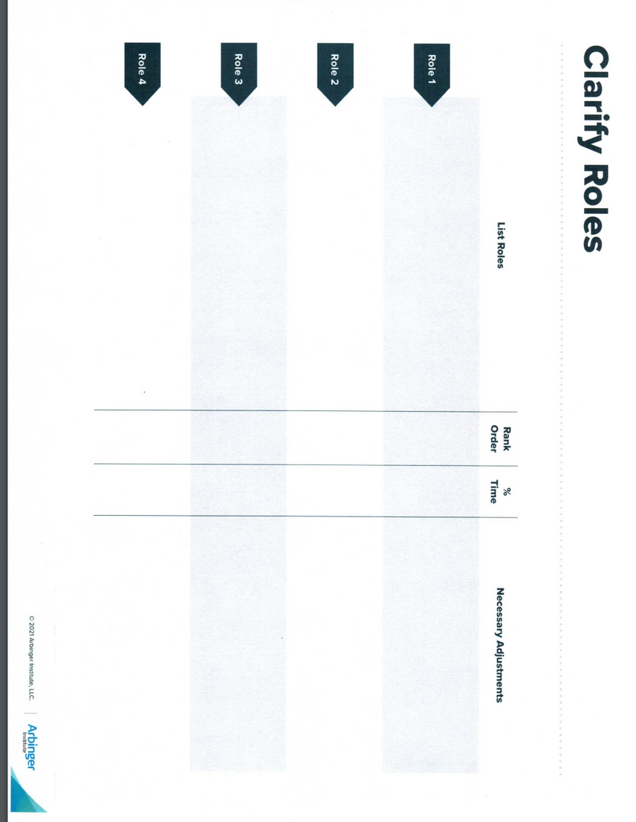
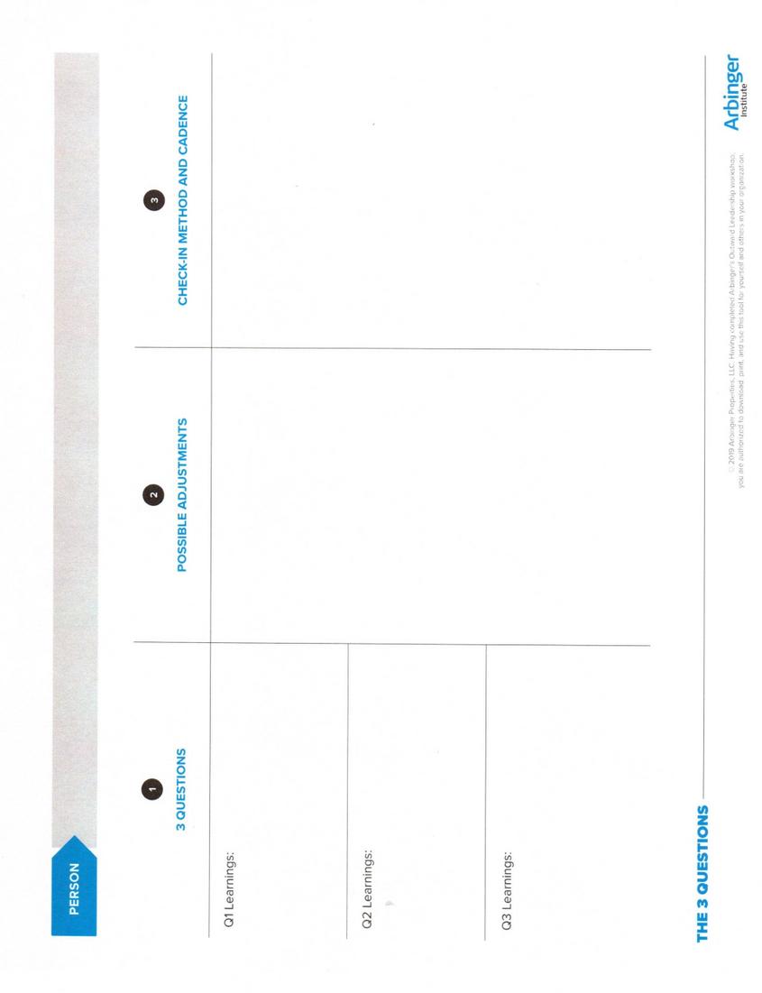
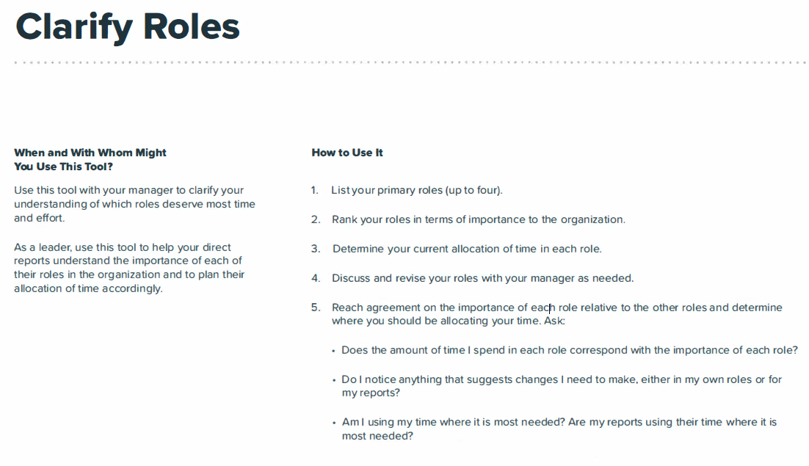
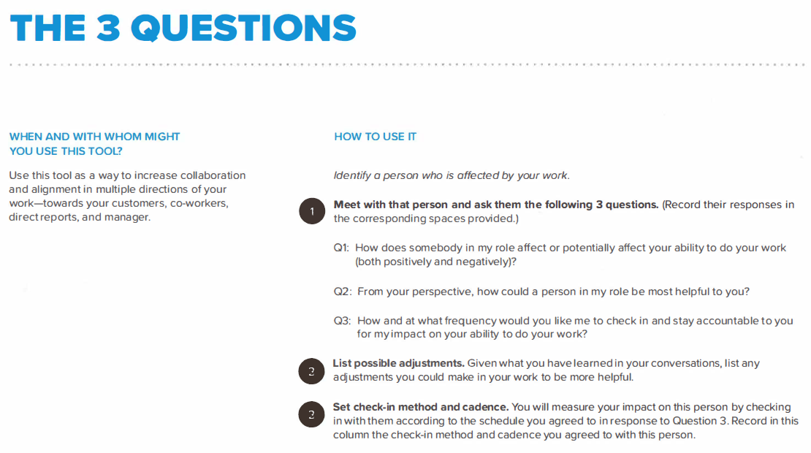
OUTWARD MINDEST RESOURCES
Notes:
Clarifying roles worksheet from Arbinger Institute - employee and supervisor should both fill out by listing all the roles the specific position may have, rank the roles by importance, and provide a percentage of how much time is allocated for that role. Finally, the employee can talk about any adjustments that may be needed.
The 3 Questions - supervisors use to support and identify how they can increase collaboration with direct reports. The 3 questions are:
1. How does somebody in my role affect or potentially affect your ability to do your work? (both positively and negatively)
2. From your perspective, how can a person in my role be most helpful to you?
3. How and at what frequency would you like me to check-in and stay accountable to you for my impact on your ability to do your work?

Slide 9
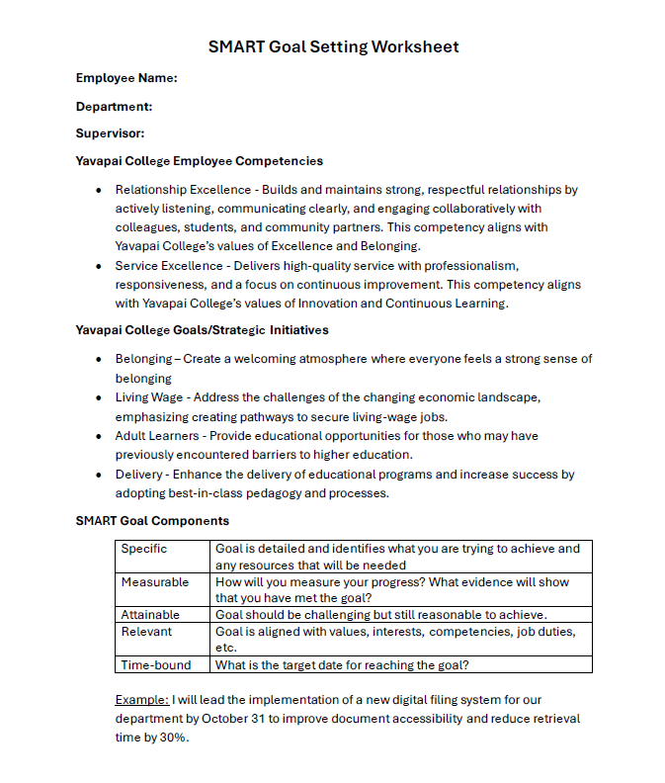
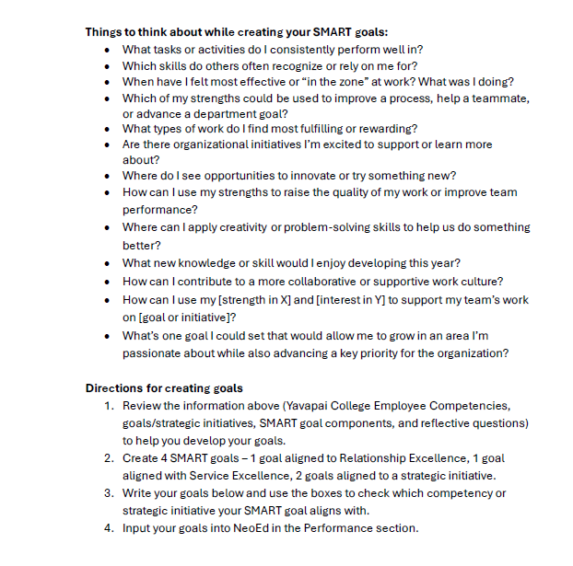
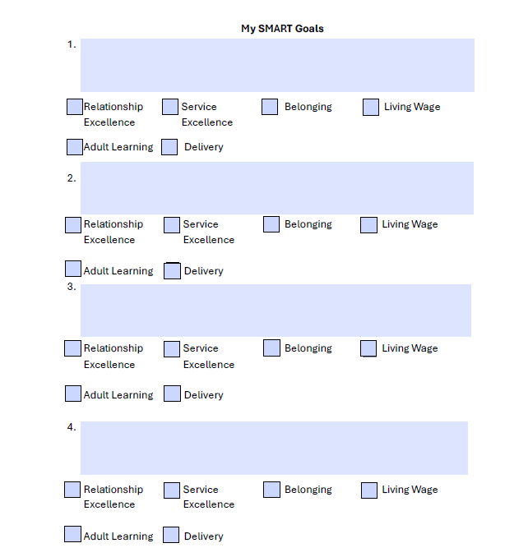

Slide 10
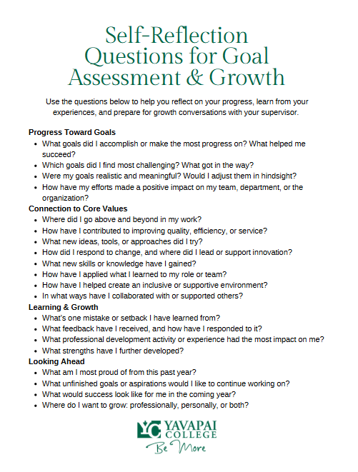
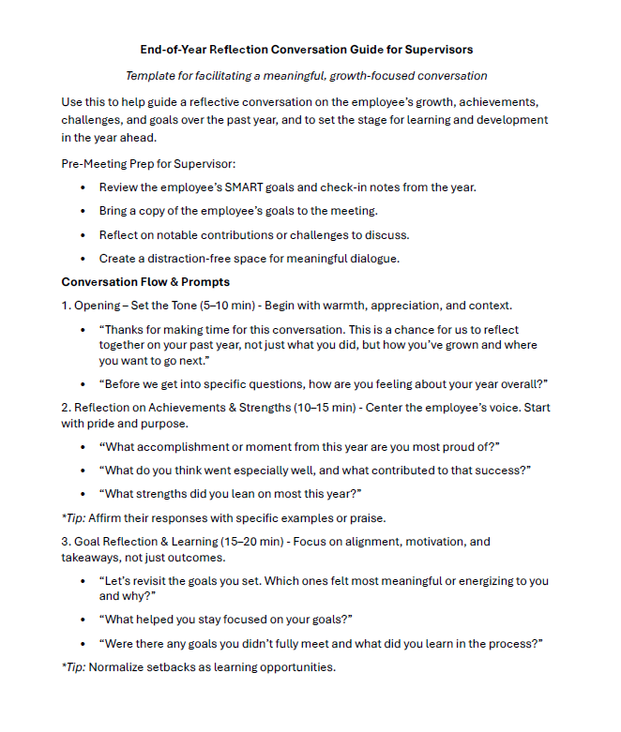
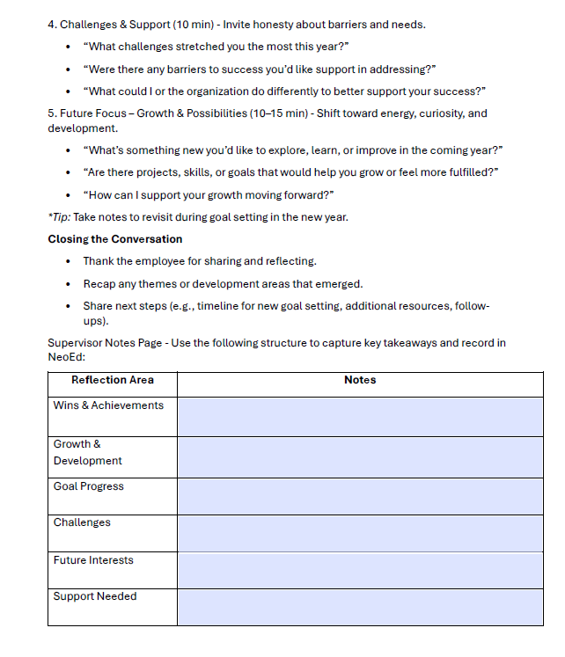

Slide 11
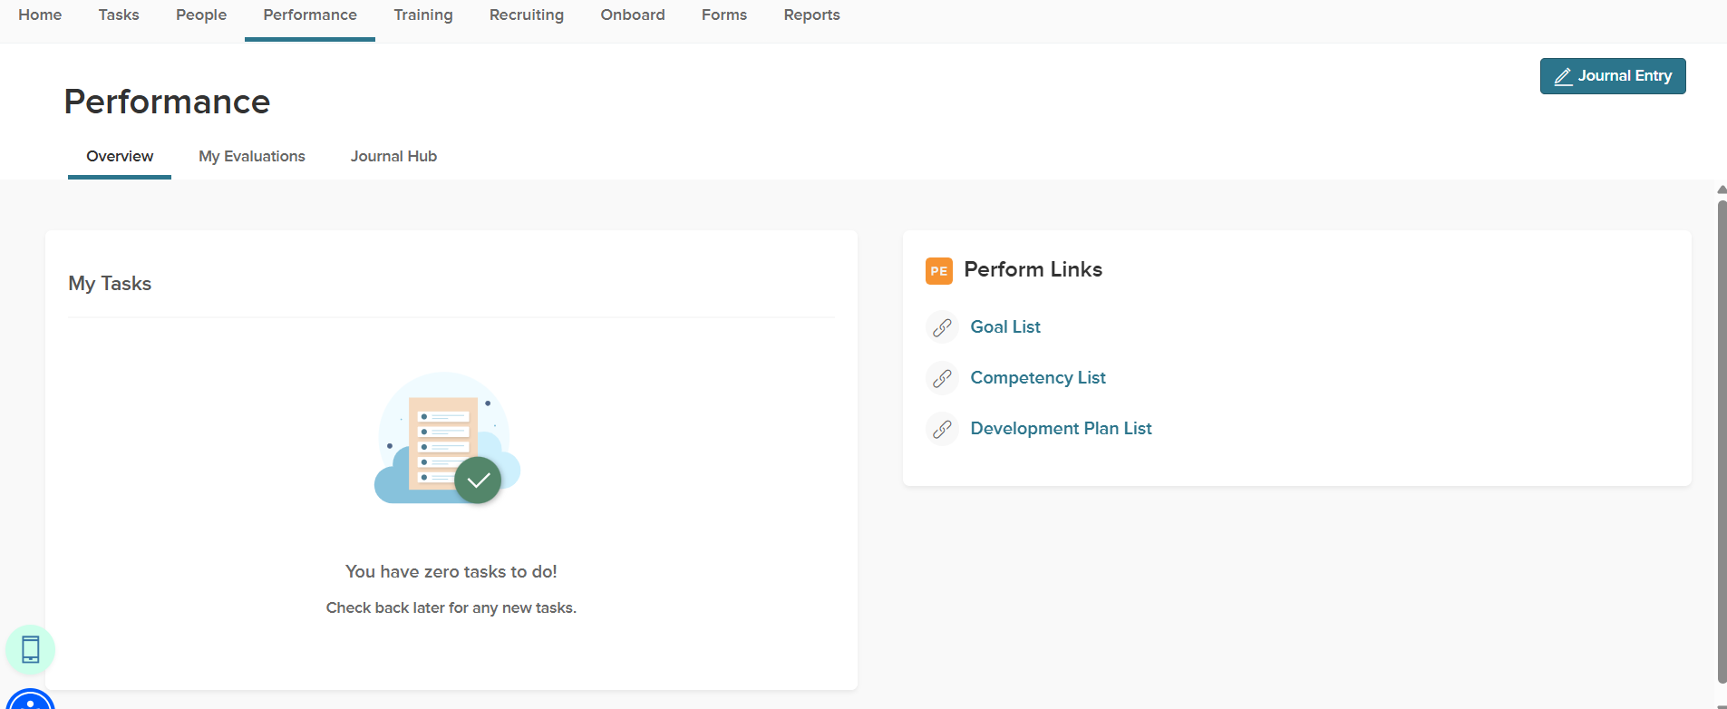
NEOED DOCUMENTATION & REVIEW
  Use Journal Entry function for documentation

Slide 12

“When performance becomes a conversation, people thrive.”
-JASON LAURITSEN

